Slide 1
Leaving your Past, and Finding His Future
Isaiah 43

Slide 2
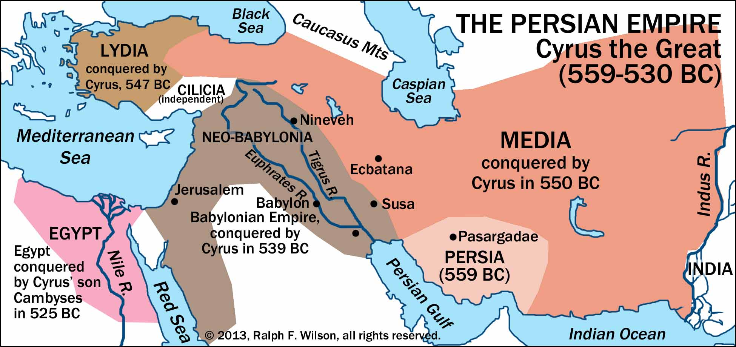

Slide 3
Redemption
גֹּאֲלָ֣ם gō·’ă·lām
Jeremiah 50:34 “Their Redeemer”
In Hebrew, the verb for redeem is pronounced in English as (ga’al), and (go’el) for Redeemer.
The basic meaning of the verb is “to buy something back.”
God buys back what is His.
God used redemption to describe the return of Israel from Egyptian slavery.
God will redeem His people in exile and bring them home. No fear.

